Slide 1
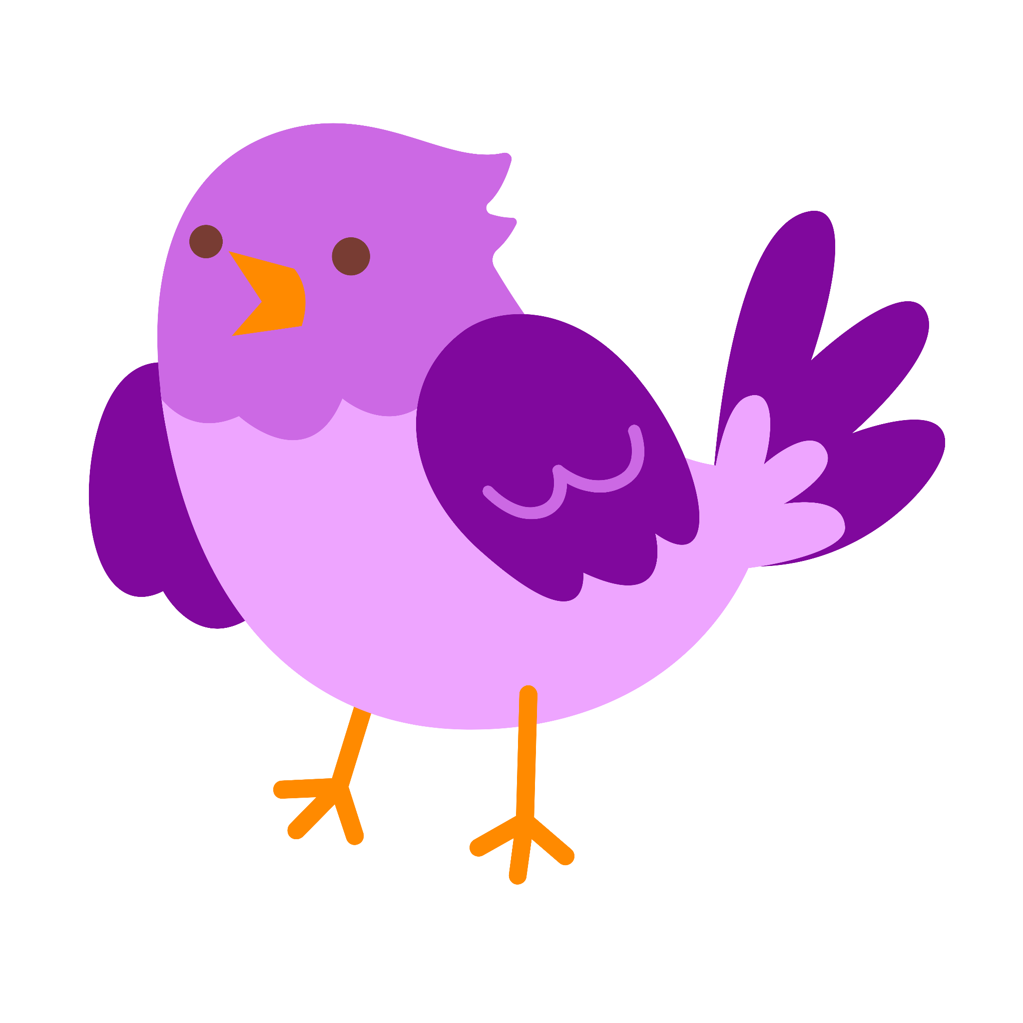
Today I want to introduce you to one of my favorite friends, Amira. She listens to you read on the ipad and helps you grow as a reader. I can't wait for her to be your friend too.
Meet Amira!
Student Slides:
Amira Intro-shortened
Early Reader Skill Scaffold

Slide 2
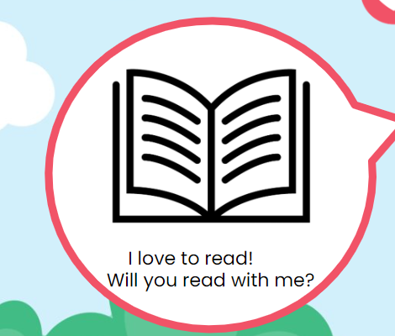
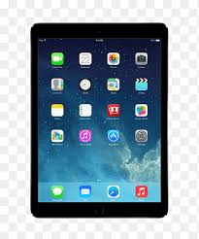
Hi, I’m Amira!
I’m so excited to meet you! We are going to read on the iPad together!

Slide 3
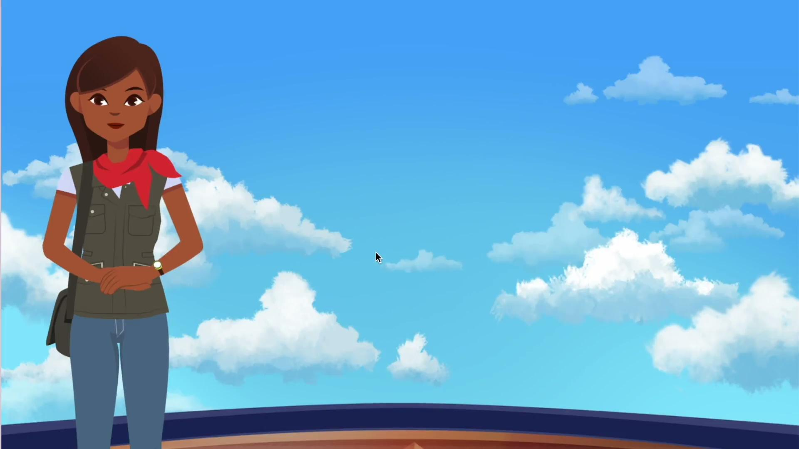
I'm going to show you how to read with Amira. Today I will teach you how to listen to and follow her directions.
Model:
-listening and paying attention
Think aloud- Amira told me the directions, now it is my turn to do it (p-a-t) pat.
Clicking allow
Clicking read a story
Point out the book and great work icon that comes up when you are finished with reading with Amira for the day.
Notes:
Vimeo link: https://vimeo.com/871601005

Slide 4
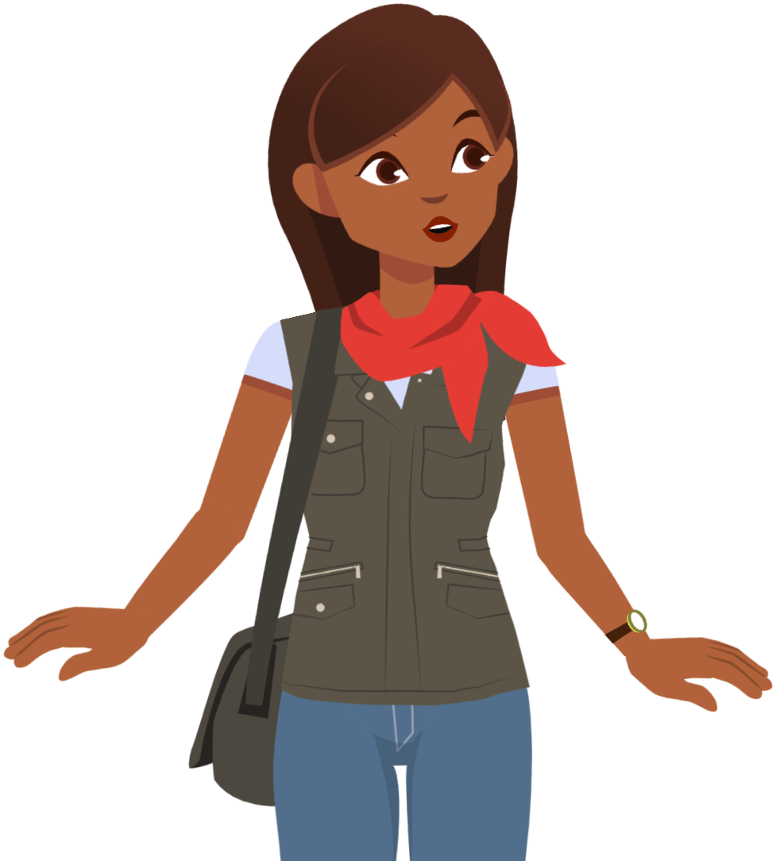
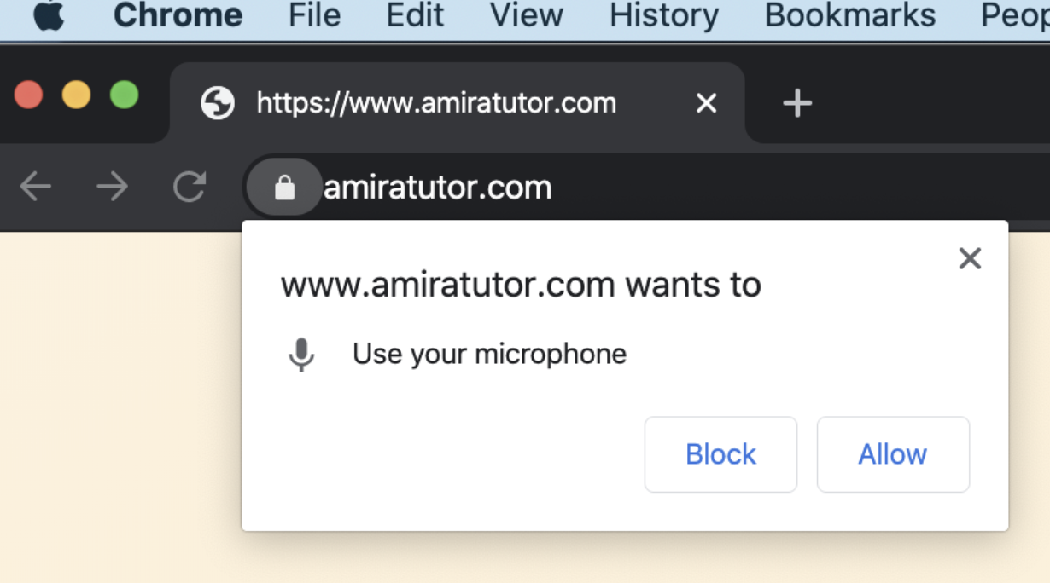
Make sure the mic is on!
You have to allow your microphone everytime you lot on to read with Amira!
Notes:
Vimeo link: https://vimeo.com/879909226

Slide 5
3
Green means GO!
Wait for the green microphone. Read loud and proud.
Notes:
Lesson 3: https://docs.google.com/document/d/1-dk0YPwAXR5-Sjv-HKH-JTMUnlVVkbsnxONGch47CMI/copy
Teacher: “I’m going to model again how you will read with Amira. Today I want to teach you that we need to use our loud and proud voice whenever there’s a green microphone. The green mic tells us Amira is ready to listen! Let me show you what I mean as I read a story with Amira today.”

Slide 6
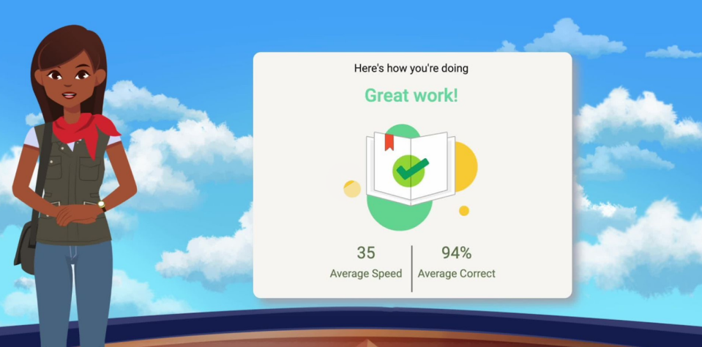
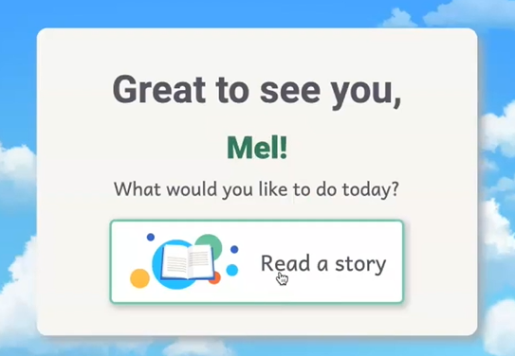
Listen to Amira, she will tell you to press the book to begin your reading with Amira.

Slide 7
When you are finished reading with Amira it will say Great work!

Slide 8
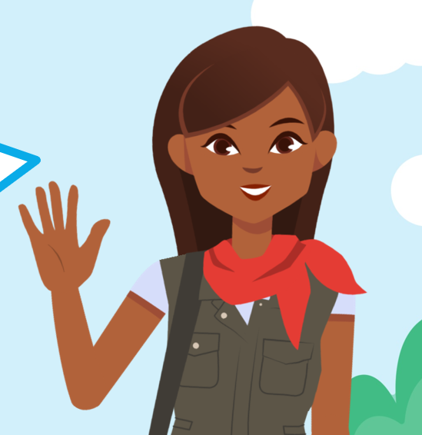
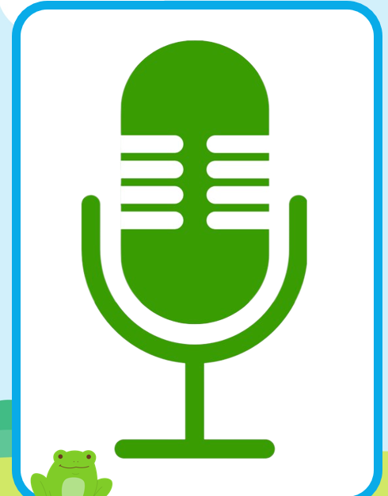
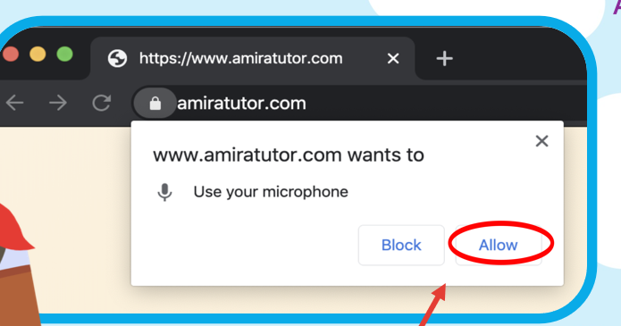
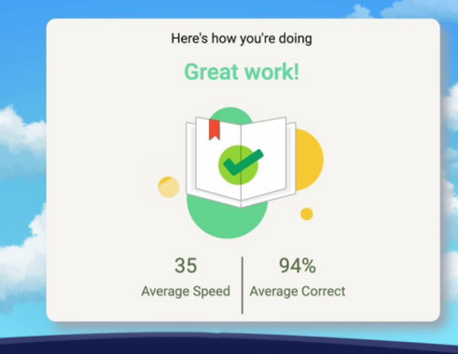
Listen to Amira’s directions
1
2
3
Click to Allow the microphone
Speak/read when the microphone turns green(loud and proud)
Press Read A Story to begin your reading time with Amira.
You will know you are finished for the day with Amira when you see “Great work” and the book at the end.
Notes:
Vimeo link: https://vimeo.com/879909226

Slide 9
Notes:
Vimeo link: https://vimeo.com/838482157

Slide 10
Listen to Amira’s directions
Review
1
2
3
Click to Allow the microphone
Speak/read when the microphone turns green(loud and proud)
Press Read A Story to begin your reading time with Amira.
You will know you are finished for the day with Amira when you see “Great work” and the book at the end.
Notes:
Vimeo link: https://vimeo.com/879909226

Slide 11
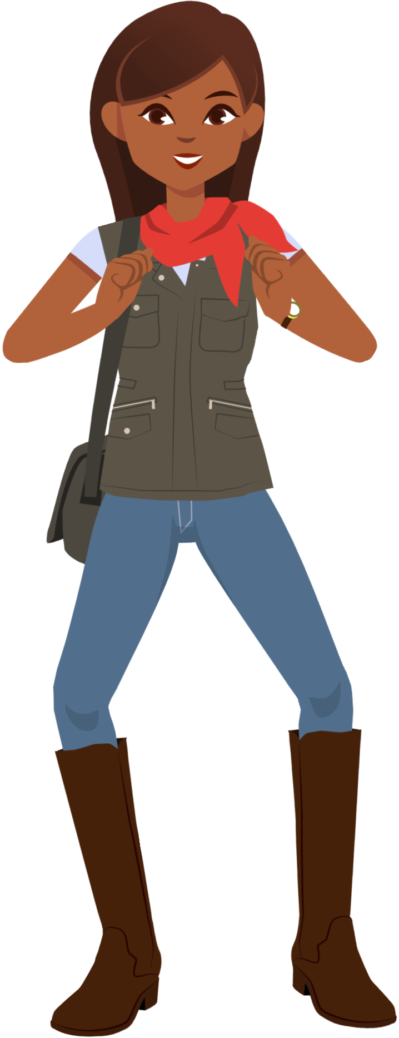
Now it’s your turn! You’ve got this!

Slide 12
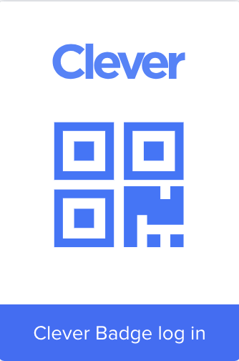
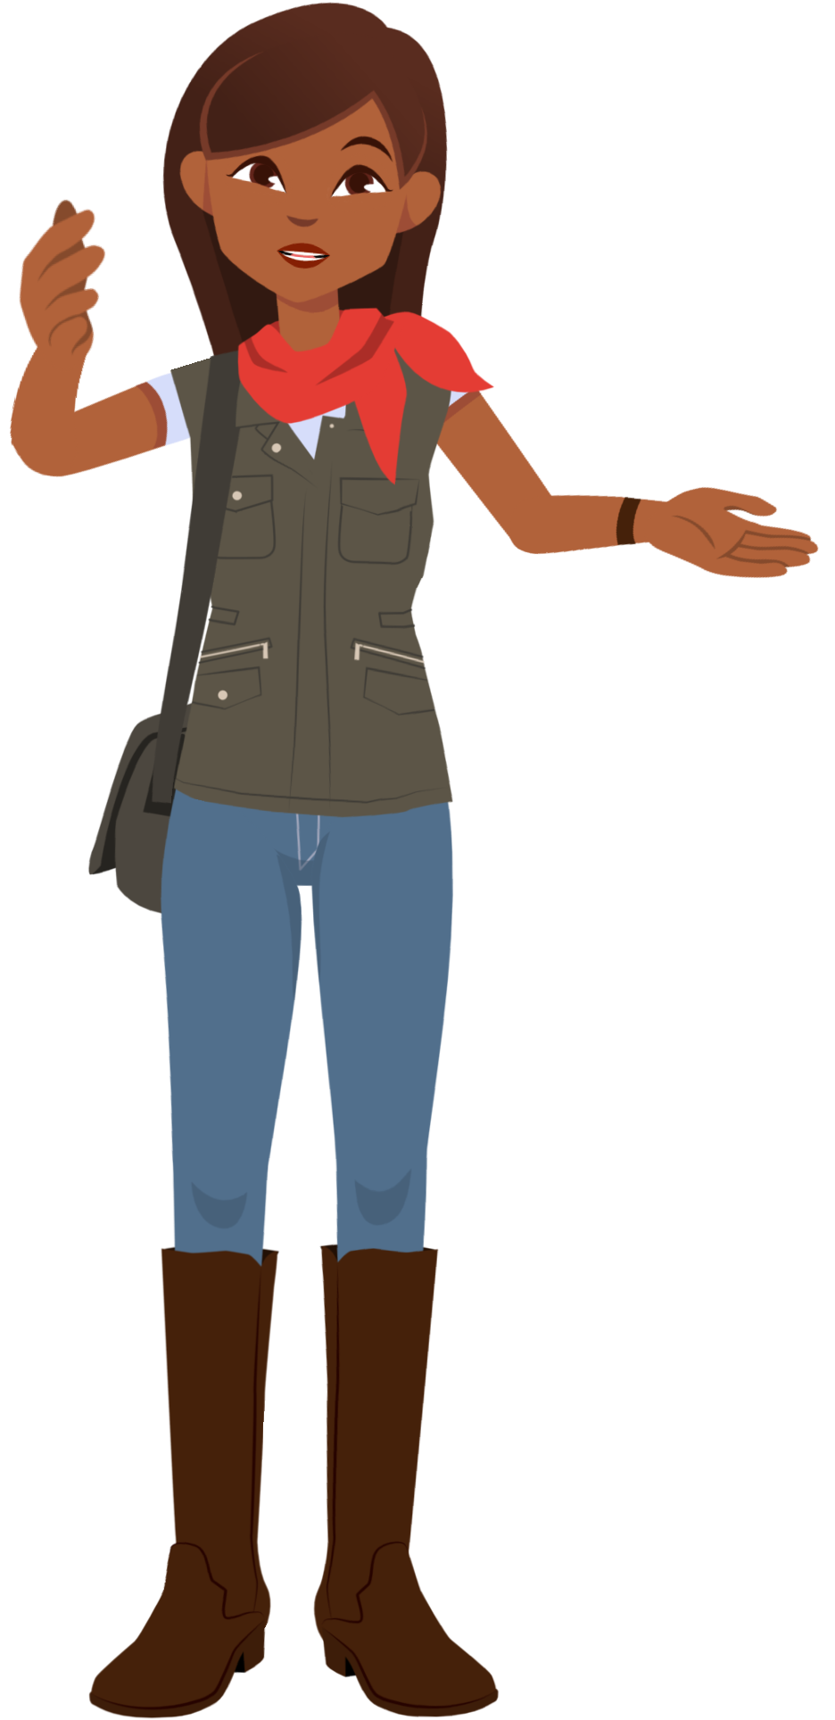
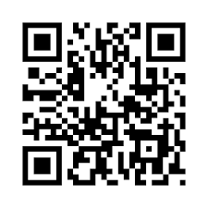
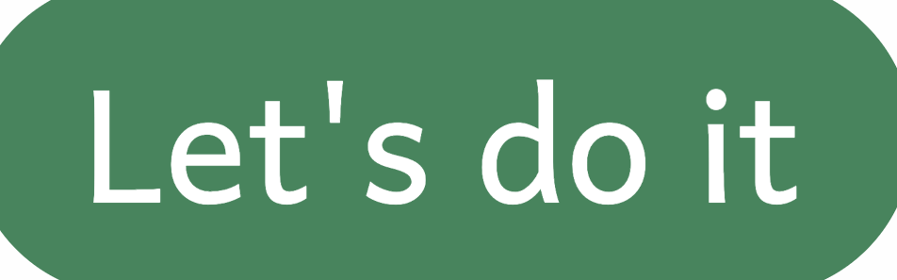
Here’s how to log in!
1
2
3
4

